Slide 1

ECG FILTER DESIGN 26 MAY ,2021
VLSI PROJECT
Prof. Dr. Gaurav Trivedi
Associate Professor of Electronics and Electrical Engineering, IIT Guwahati
Ms. Meenali Janveja Research Scholar IIT Guwahati

Slide 2

LITERATURE REVIEW
ECG FILTERS

Slide 3
Recommendations for the Standardization and Interpretation of the Electrocardiogram
https://www.ahajournals.org/doi/pdf/10.1161/CIRCULATIONAHA.106.180200
https://www.scireslit.com/VascularMedicine/AJVM-ID18.pdf
https://www.ncbi.nlm.nih.gov/pmc/articles/PMC3388307/

Slide 4
Data set MIT-BIH Arrhythmia Database
https://www.physionet.org/content/mitdb/1.0.0/ The recordings were digitized at 360 samples per second per channel with 11-bit resolution over a 10 mV range. Two or more cardiologists independently annotated each record; disagreements were resolved to obtain the computer-readable reference annotations for each beat (approximately 110,000 annotations in all) included with the database.

Slide 5
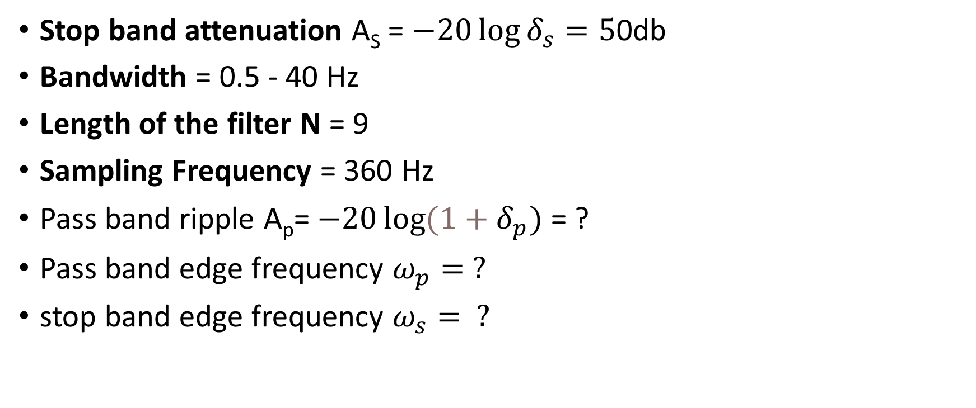
SPECIFICATION USED:
Stop band attenuation A_{S} = $−20\log{δ_{s}}=5$0db
Bandwidth = 0.5 - 40 Hz
Length of the filter N = 9
Sampling Frequency = 360 Hz
Pass band ripple A_{p}= $−20\log{{(1+δ}_{p})}$ = ?
Pass band edge frequency $ω_{p}= ?$
stop band edge frequency $ω_{s}= ?$

Slide 6
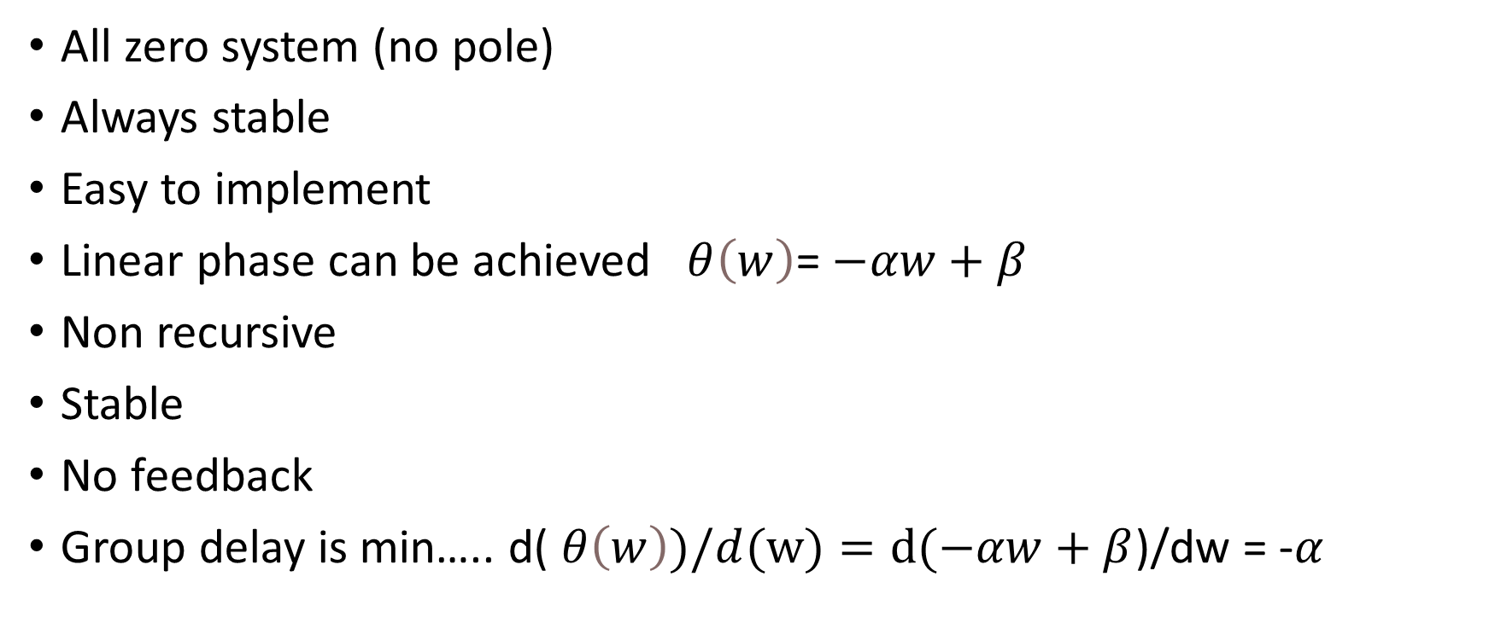
FIR FILTER
All zero system (no pole)
Always stable
Easy to implement
Linear phase can be achieved $θ\left(w\right)$= $−αw+β$
Non recursive
Stable
No feedback
Group delay is min….. d( $θ\left(w\right))/d(w)=d(−αw+β$)/dw = -$α$

Slide 7

Linear phase FIR filter
TYPE 1
Symmetrical ($β=0 or Π)$
N= odd
h(n)=h(N-1-n) where N is the length of the filter
Best choise to design

Slide 8
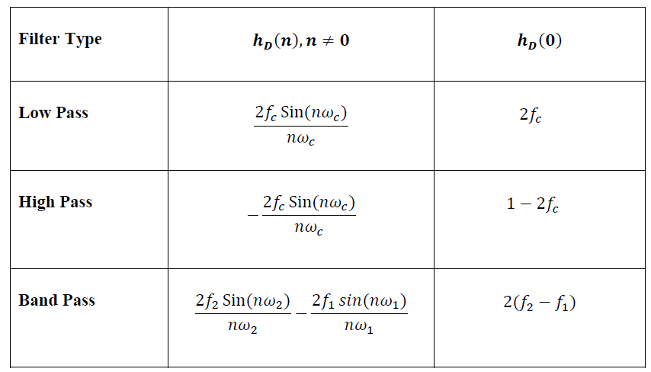

Slide 9
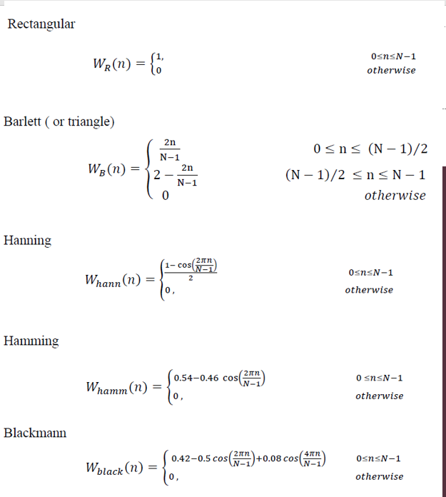

Slide 10
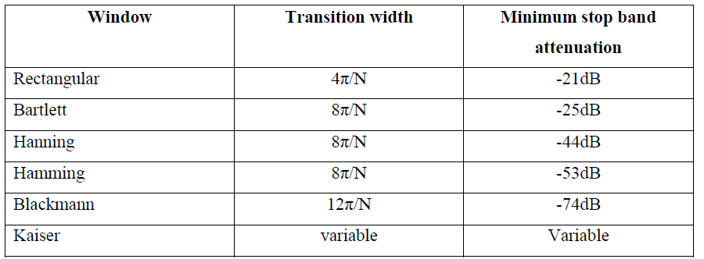

Slide 11
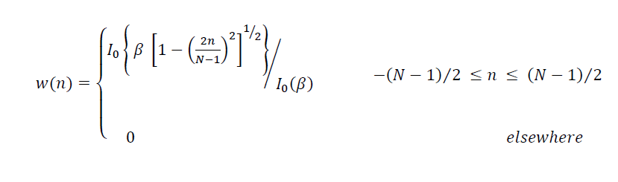
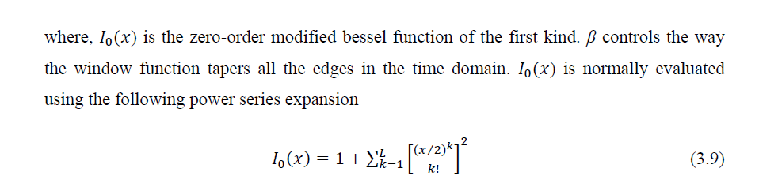
Kaiser window

Slide 12
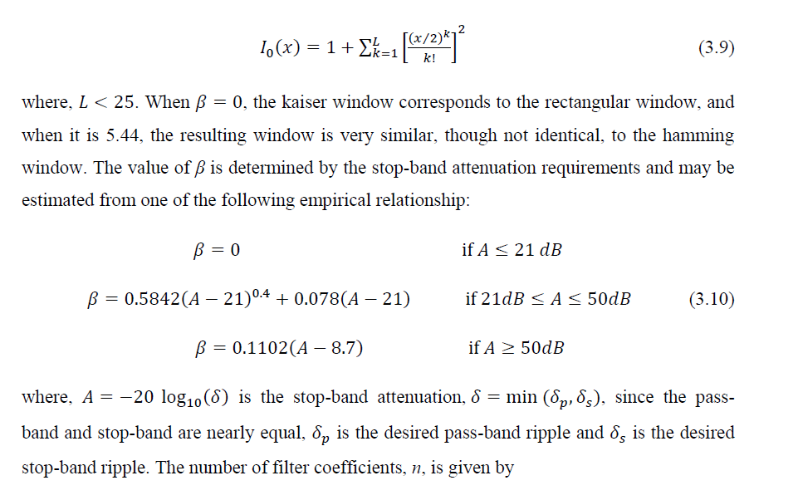
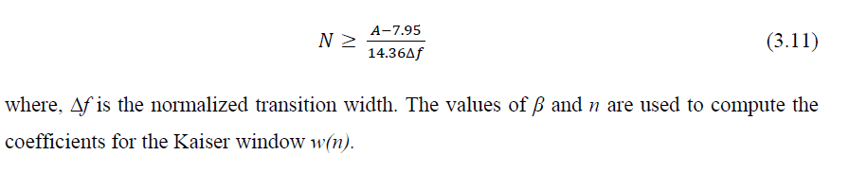

Slide 13
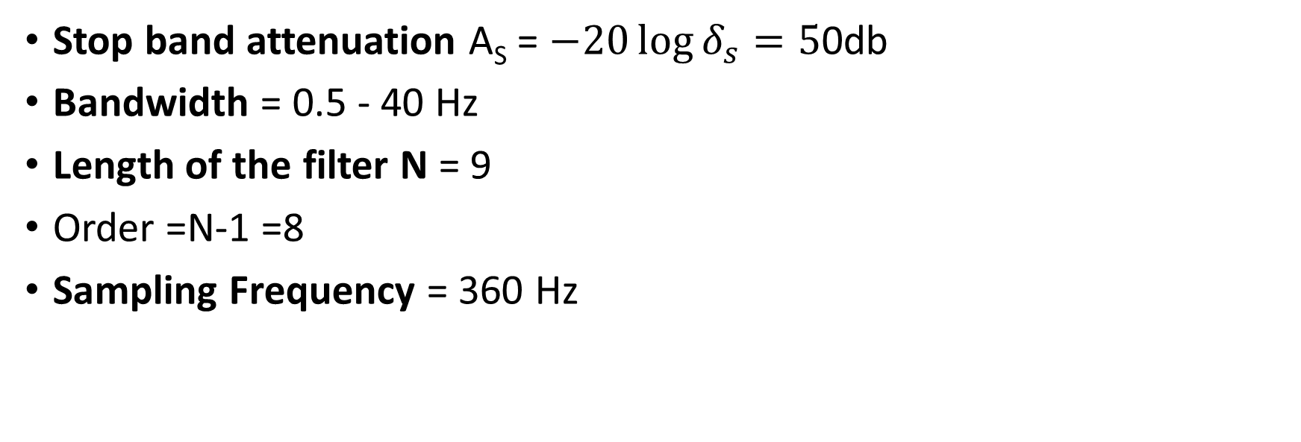
SPECIFICATION USED:
Stop band attenuation A_{S} = $−20\log{δ_{s}}=5$0db
Bandwidth = 0.5 - 40 Hz
Length of the filter N = 9
Order =N-1 =8
Sampling Frequency = 360 Hz

Slide 14
FOLLOWING MATLAB SIMULATION OUTPUT USES
MIT-BIH Physionet 100.dat as dataset
https://physionet.org/content/mitdb/1.0.0/100.dat

Slide 15
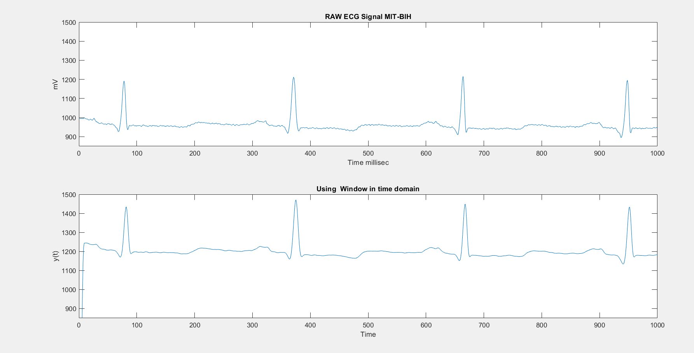
RECTANGULAR WINDOW

Slide 16
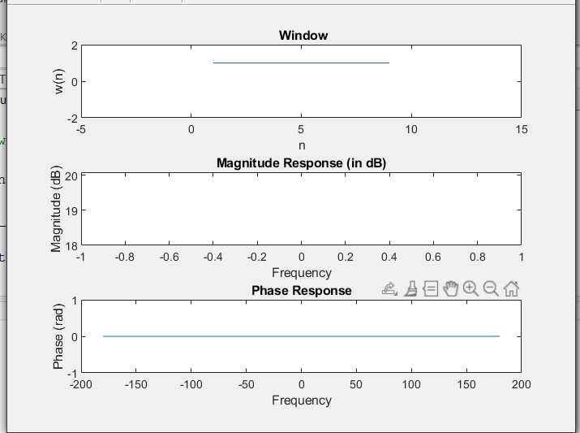

Slide 17
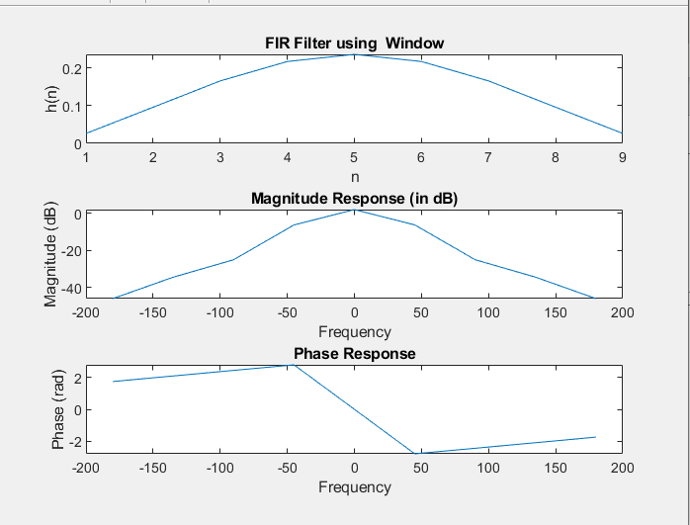
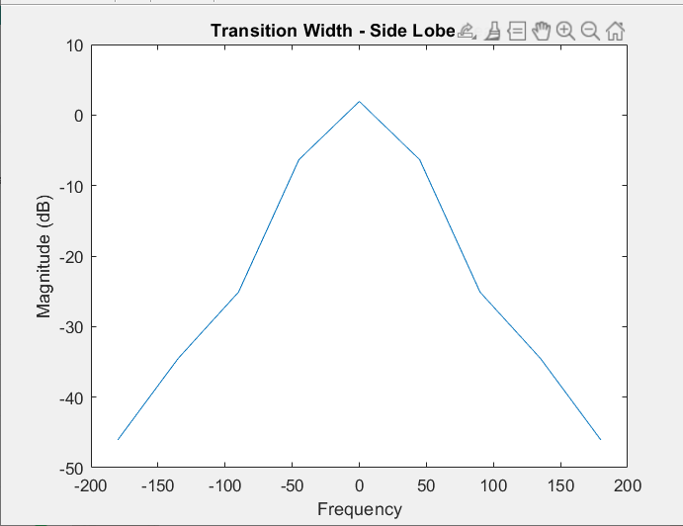
h(n) =[ 0.0264 0.0961 0.1661 0.2177 0.2367 0.2177 0.1661 0.0961 0.0264]

Slide 18
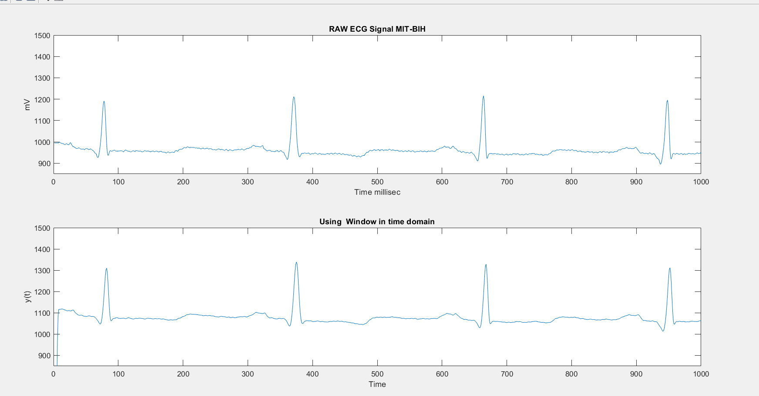
BARTLETT WINDOW

Slide 19
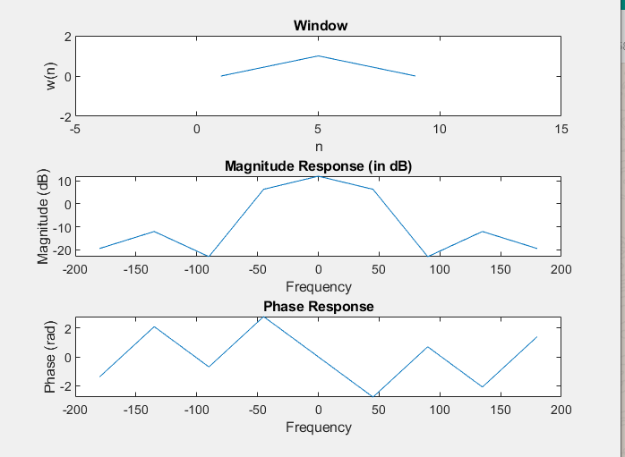

Slide 20
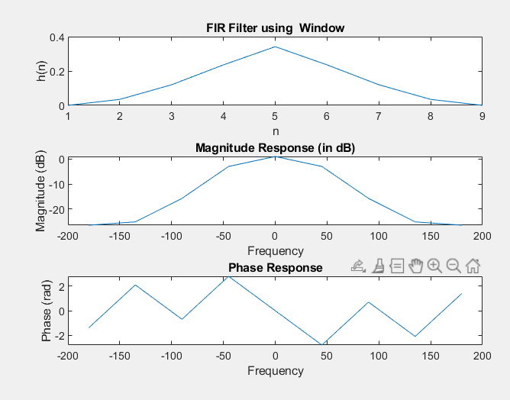
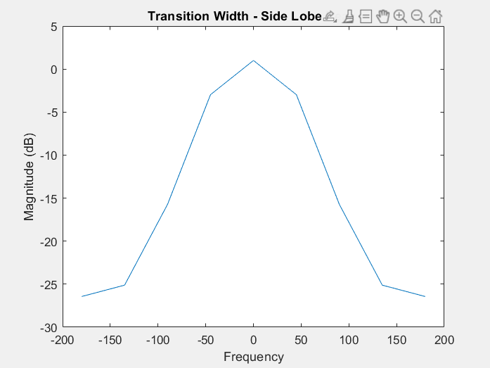
h(n) =[0 0.0347 0.1198 0.2357 0.3416 0.2357 0.1198 0.0347 0]

Slide 21
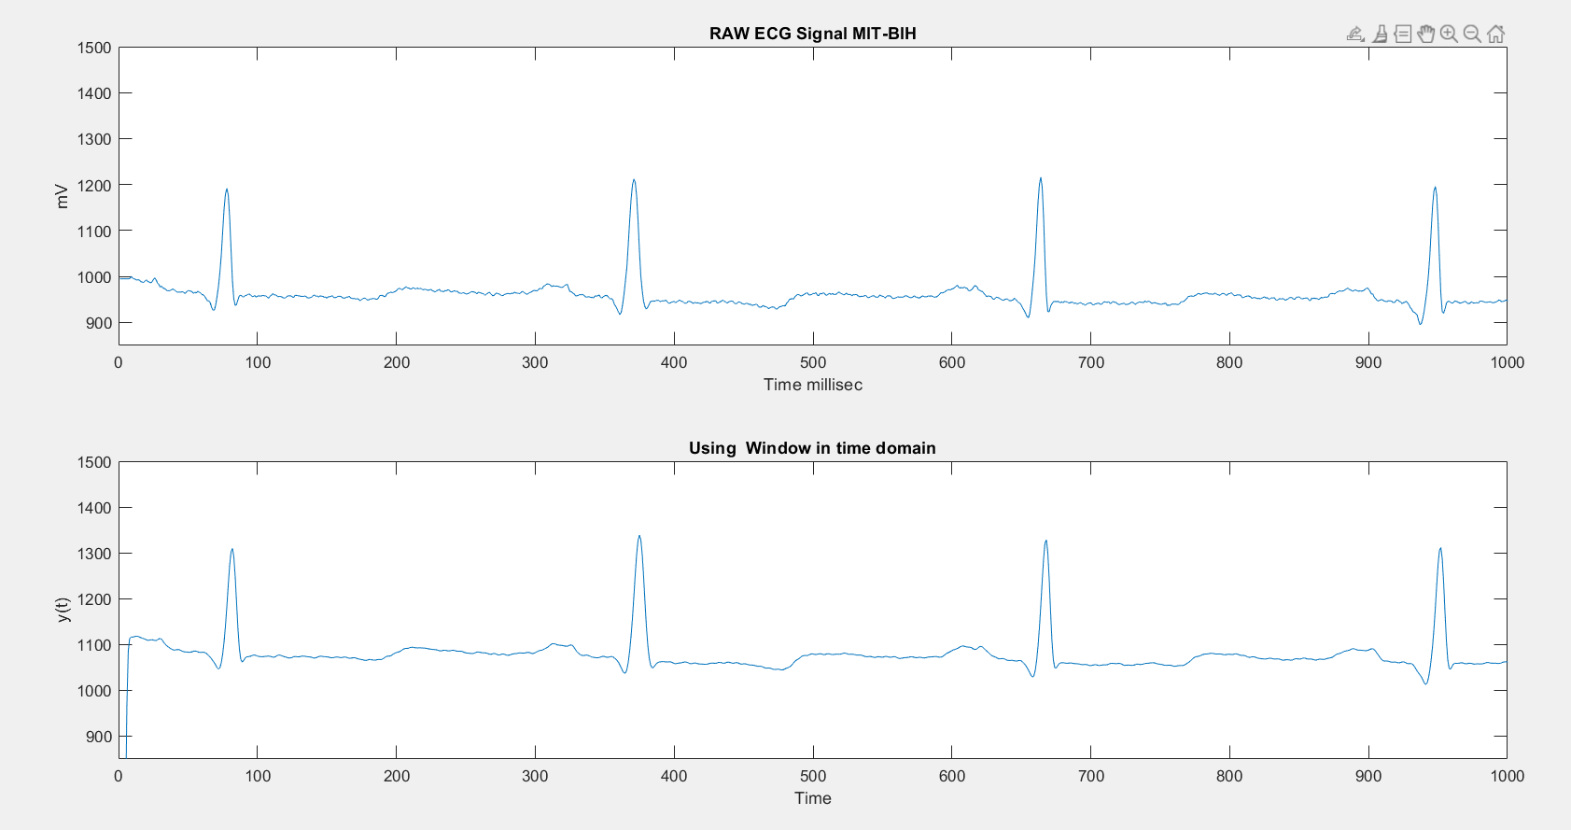
HAMMING WINDOW

Slide 22
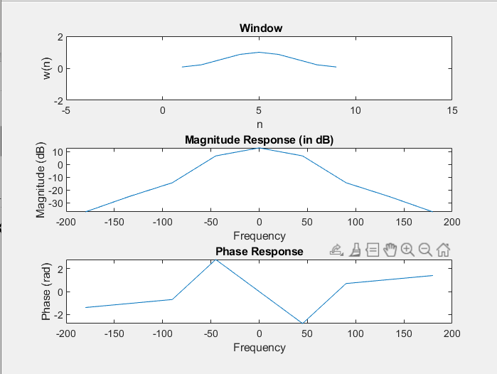

Slide 23
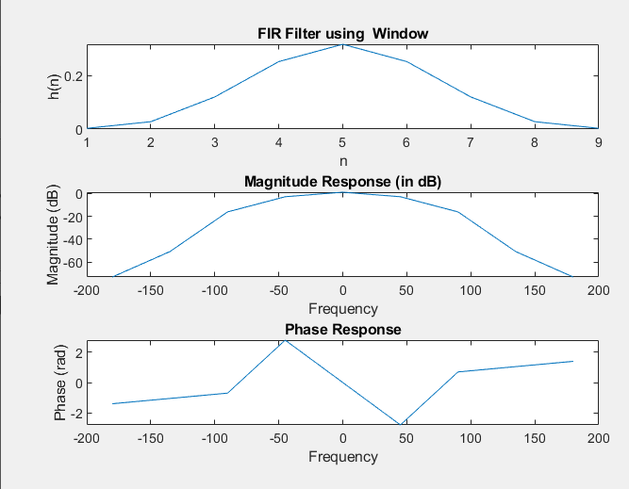
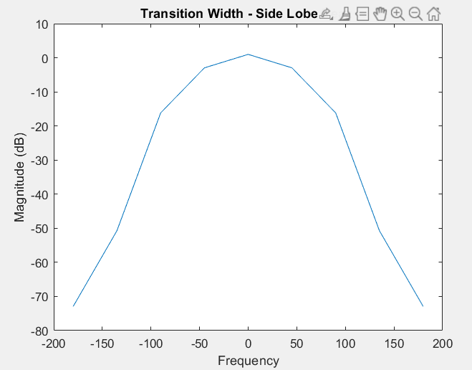
h(n) =[0.0028 0.0276 0.1200 0.2520 0.3167 0.2520 0.1200 0.0276 0.0028]

Slide 24
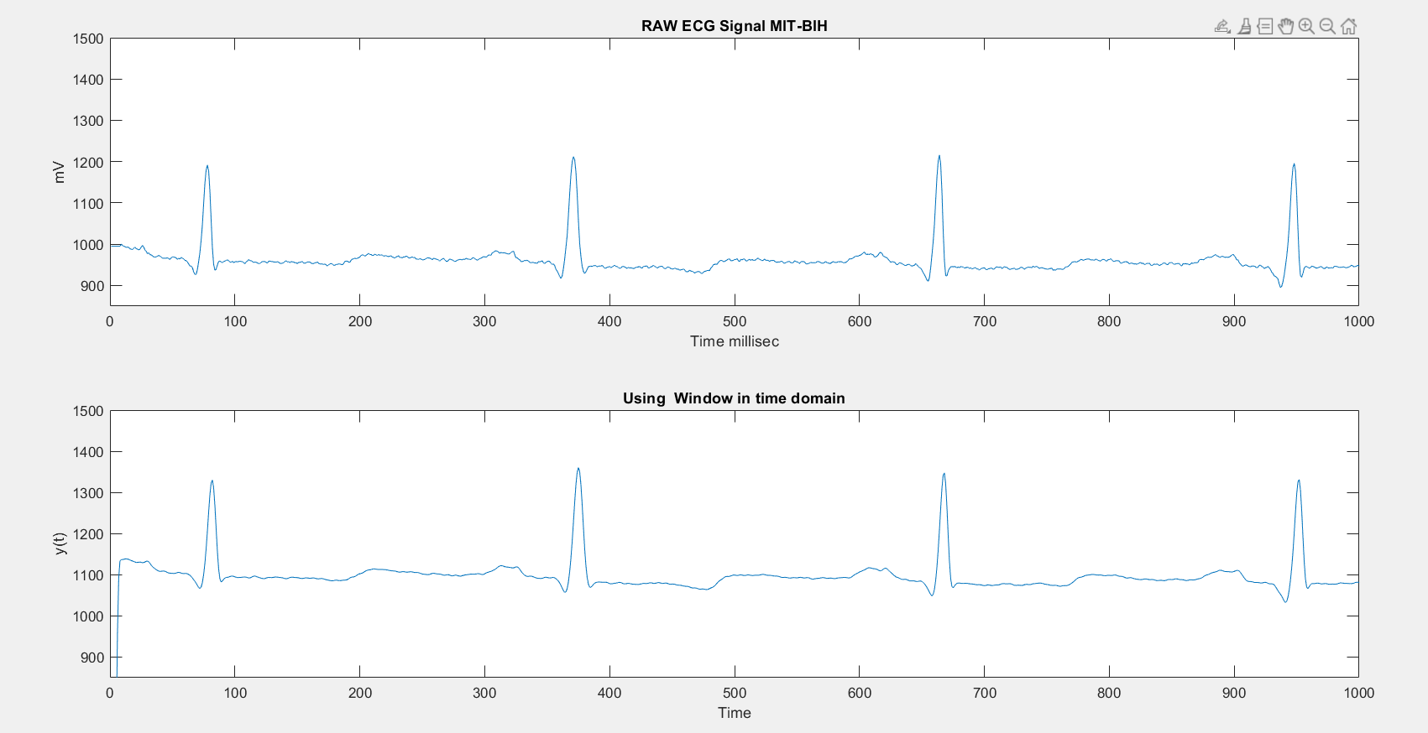
HANNING WINDOW

Slide 25
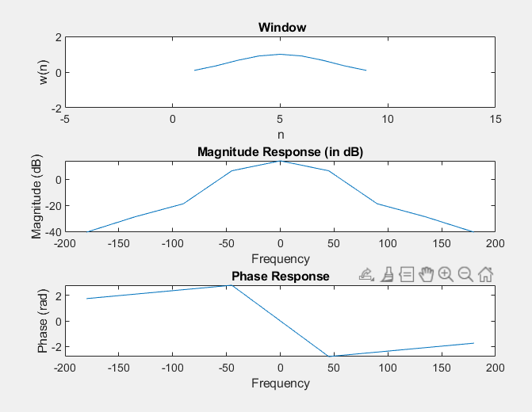

Slide 26
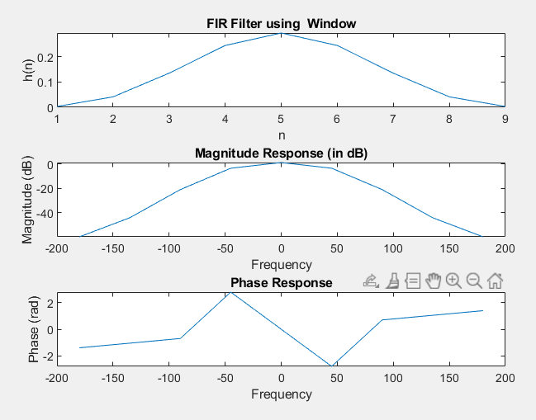
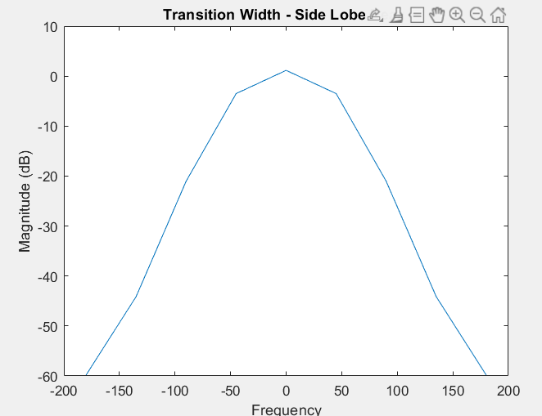
h(n) =[0.0031 0.0413 0.1351 0.2447 0.2941 0.2447 0.1351 0.0413 0.0031]

Slide 27
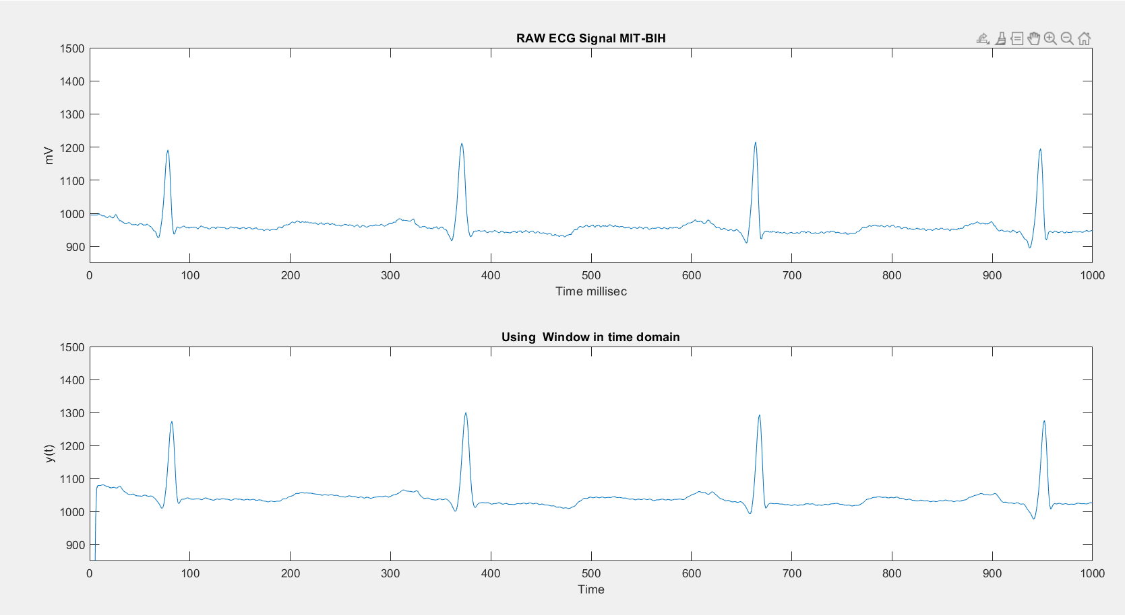
BLACKMANN WINDOW

Slide 28
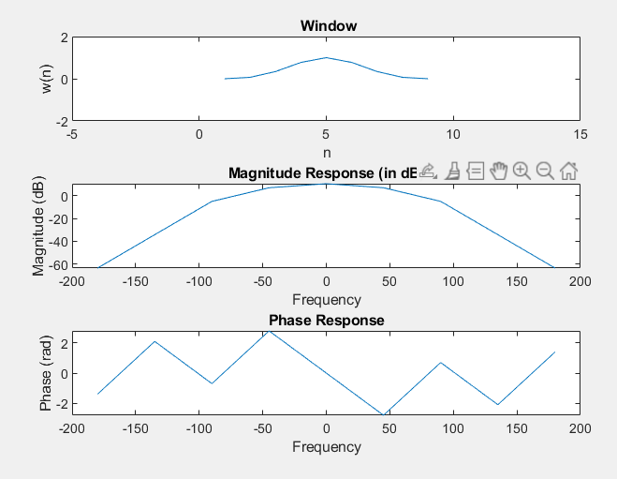

Slide 29
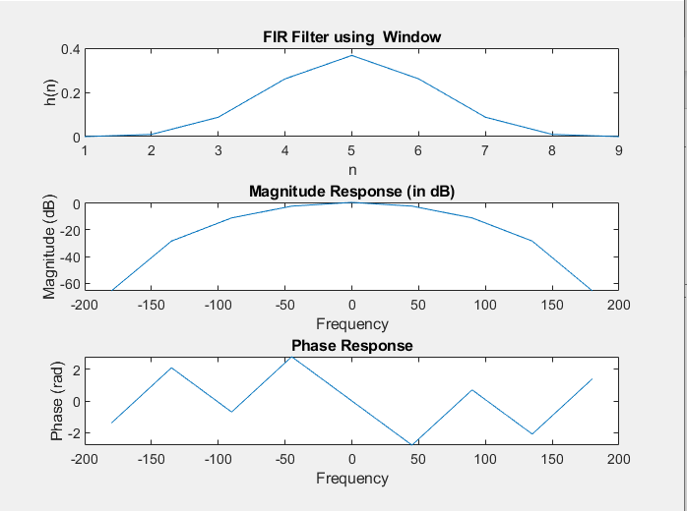
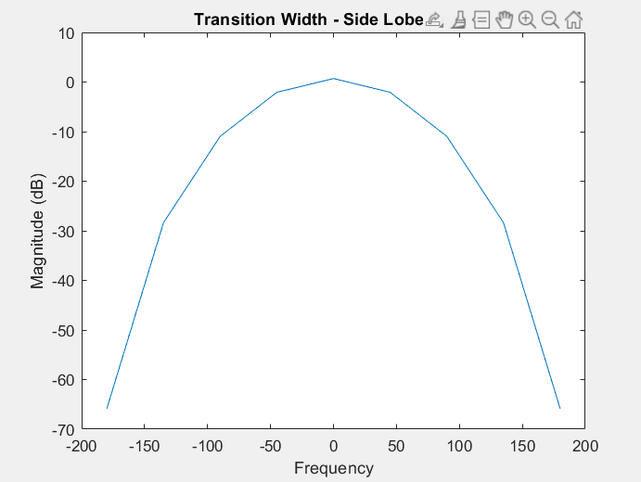
h(n) =[0 0.0099 0.0876 0.2612 0.3671 0.2612 0.0876 0.0099 0]

Slide 30
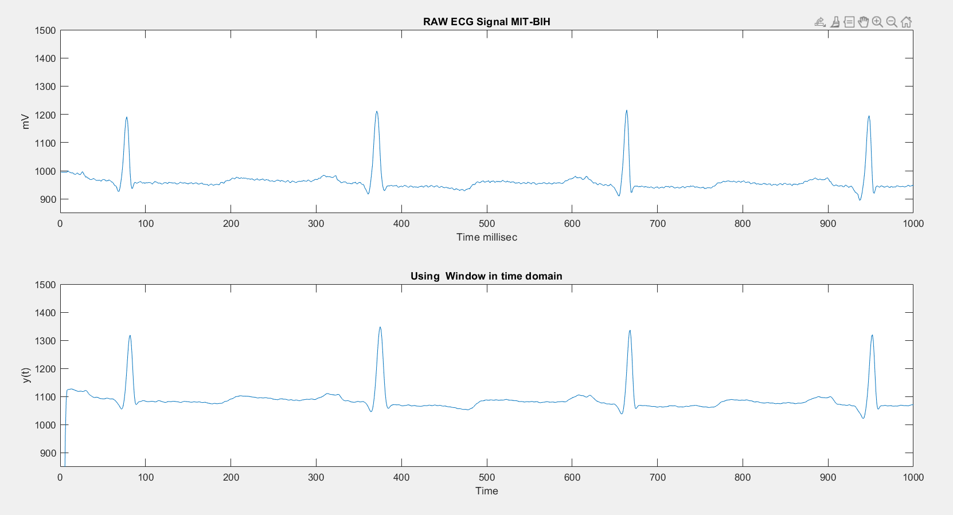
CHEBYCHEV WINDOW

Slide 31
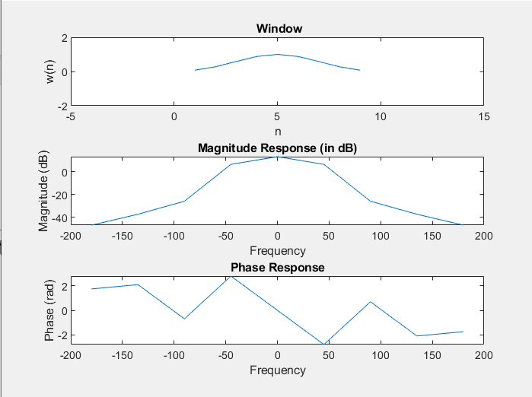

Slide 32
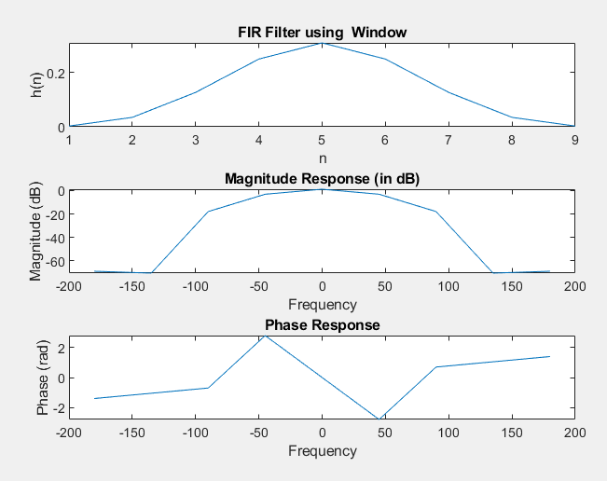
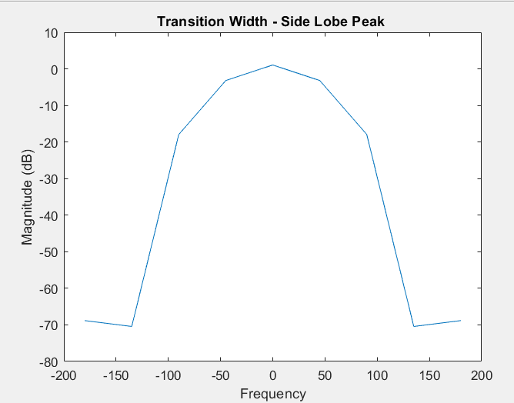
h(n) =[0.0027 0.0345 0.1260 0.2484 0.3078 0.2484 0.1260 0.0345 0.0027]

Slide 33
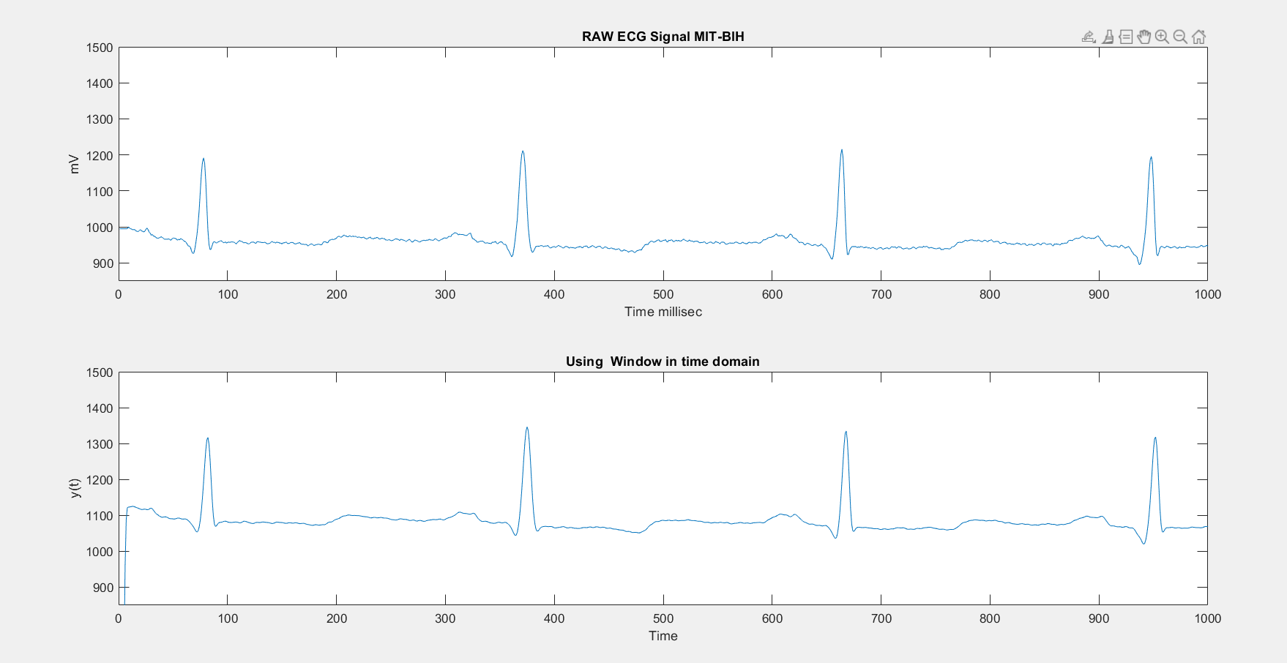
KAISER WINDOW

Slide 34
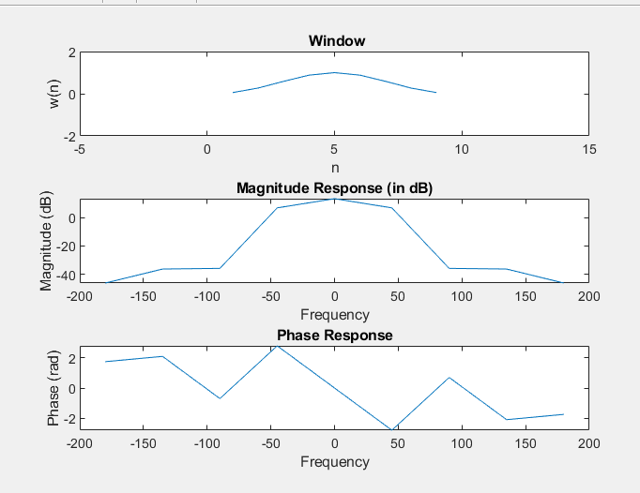

Slide 35
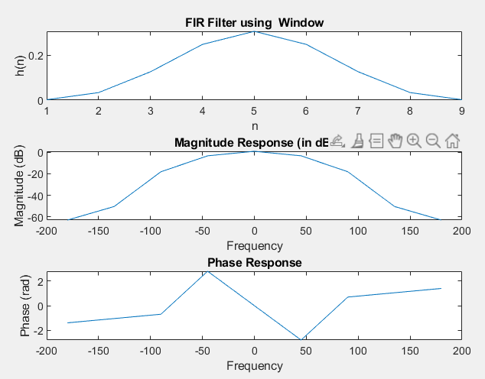
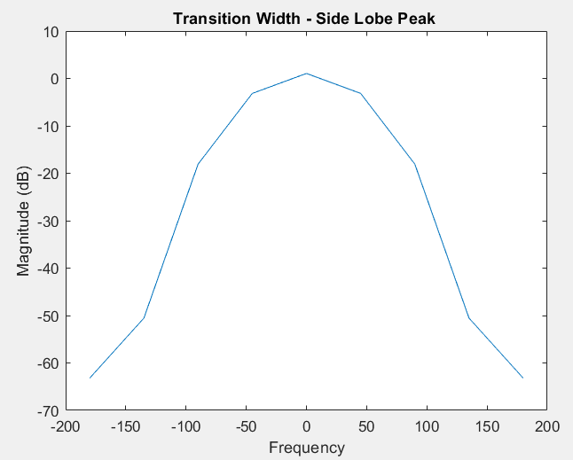
SHAPE PARAMETER (beta) = 4.5513
h(n) =[0.0019 0.0336 0.1266 0.2488 0.3072 0.2488 0.1266 0.0336 0.0019]

Slide 36
Comparing windows
Now among different window function we select Kaiser window function for this application because its provides maximum stop band attenuation as compared to other window functions and also has a ripple control parameter and it is also more efficient in terms of the number of coefficients to meet the same specifications. Kaiser window is one of the useful and optimum window, optimum in sense of providing large main lobe width for the given stop-band attenuation which gives the sharpest transition width and it also provide flexible transition bandwidth.

Slide 37
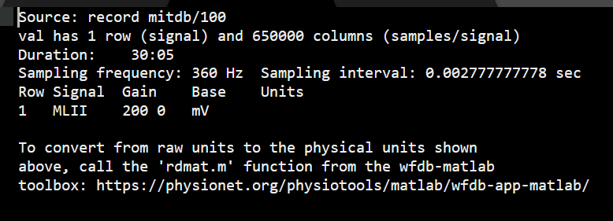

Slide 38
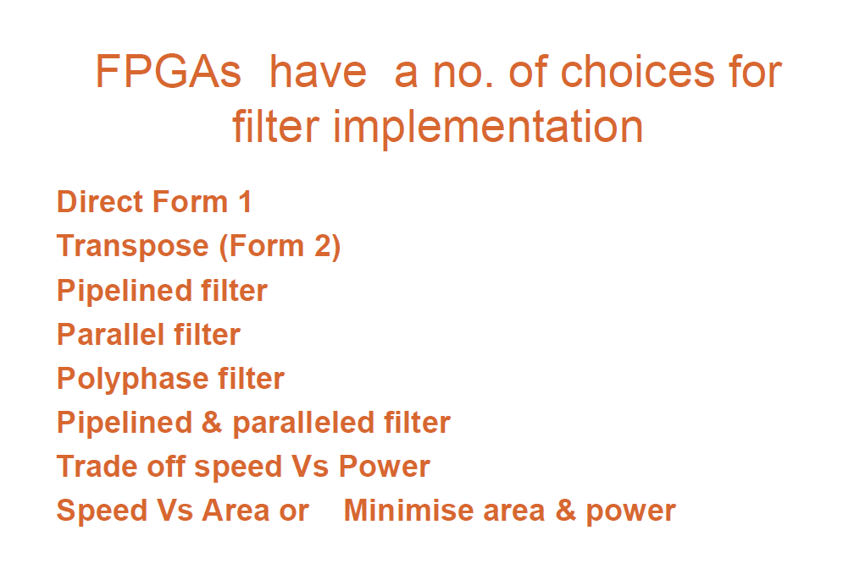

Slide 39
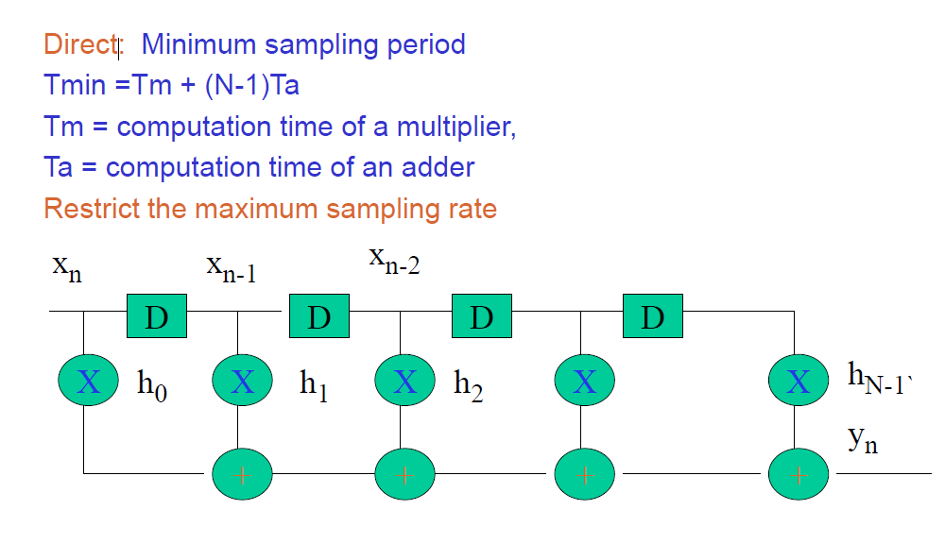
Direct form 1

Slide 40
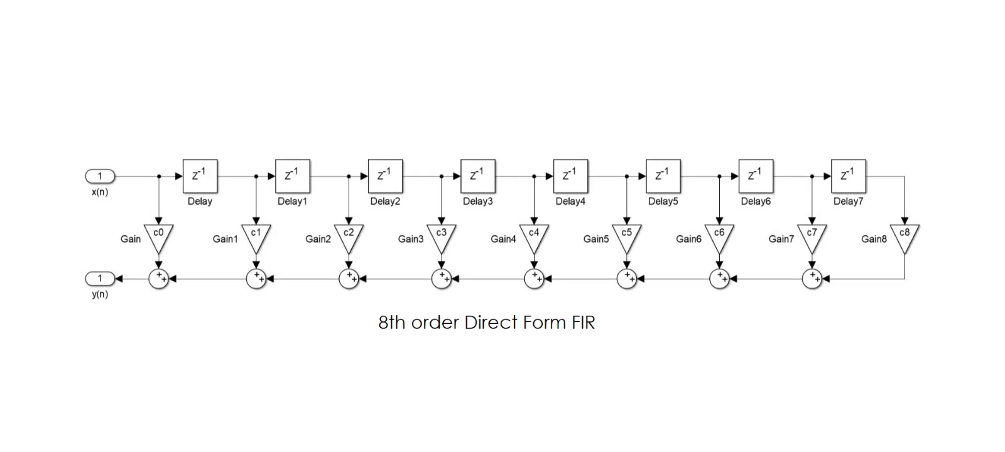
Direct form suffers delay , low performance however simple to design

Slide 41
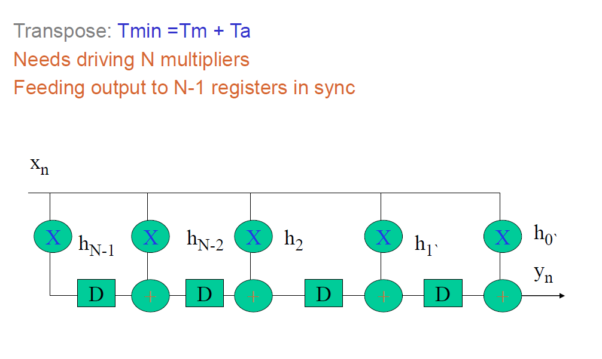
Direct form 2- pipelined

Slide 42
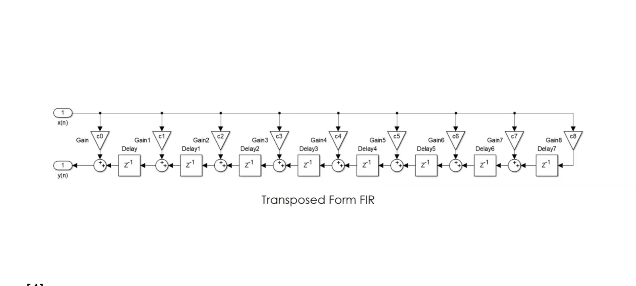
Pipelined - Direct form II TRANSPOSED STRUCTURE

Slide 43
Direct form 2 advantage than Direct form 1
Higher sampling rate
Delay is low

Slide 44
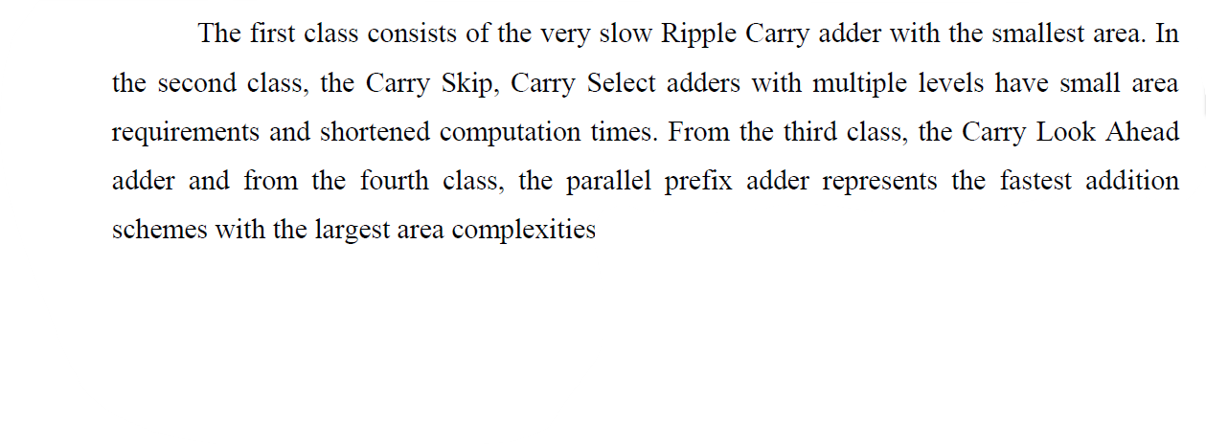
Adders

Slide 45
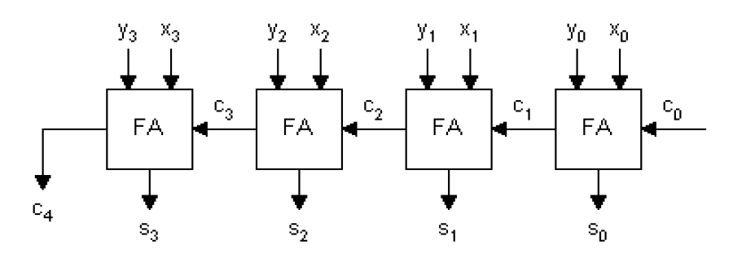
4-bit Ripple carry adder

Slide 46
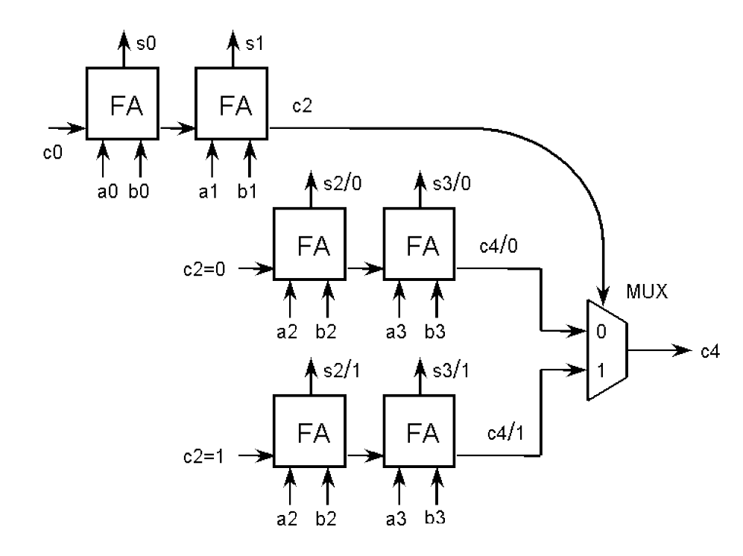
4-bit Carry select adder

Slide 47
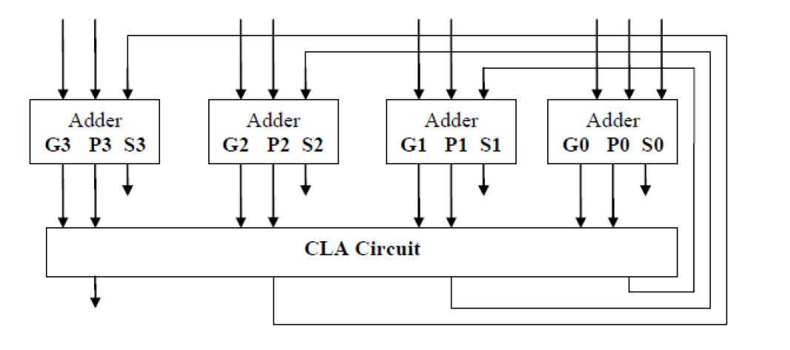
4-bit carry look ahead adder

Slide 48
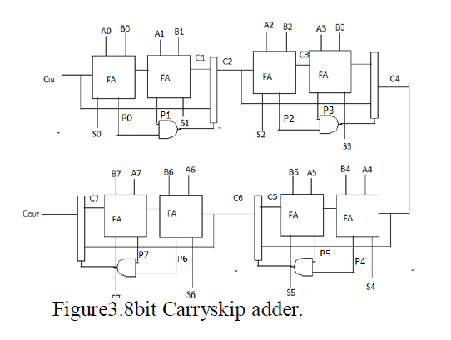
8- bit carry skip adder

Slide 49

8 – bit carry look ahead adder

Slide 50

Carry select adder

Slide 51


Adders
1. Ripple carry adder – cascade of FA – Slowest – n bit>>n full adders
Not efficient and high delay when bit size increases
2. Carry select adder – less delay (1/2 of ripple carry adder )
Faster & Less delay but mux occupy area . O(n$\sqrt{n} )$
3. Carry look ahead adder – fastest in carry bypass logic in generating carry bits. As the no of bits increases , complexity increases as well as no of gates required for generating bypass logic increases>>more area and more power. The traditional CLA adder are not recommened to be designed as it consumes high power and more area, though fastest.
4. Carry skip adder – Carry bypass logic >>less delay than ripple carry adder

Slide 52
Multipliers
Fastest – parallel multipliers like Wallace tree .
But Wallace suffers bad regularity and hard to design with high efficiency due to its complex layout.
So, when high performance ,lower power ,regularity is the primary concern , it is better to opt modified booth algo radix 4 or 8.
Modified Booth multiplier radix 4 on signed no’s in 2s complement .
No of partial products are reduced to n/2 in case of modified radix 4 booth multiplier.
In our case ,we will stick to radix 4 as no of bit we use is only 8 bits for signed multiplication.

Slide 53
Memory occupancy
Booth multiplier has maximum number of ROMs, macros and BELS.
Wallace tree has minimum number of BELS and macros compared to Booth and Dadda multiplier.
Also,Wallace tree multiplier and Dadda multiplier have no flip-flops and Booth multiplier has maximum flip-flops.

Slide 54
8 X 8 bits Dadda and Wallace tree multipliers.
• Wallace tree multiplier uses 38 full adders and 15 half adders.
• Dadda multiplier uses 35 full adders and 7 half adders.
• Wallace tree multiplier requires a carry-propagate adder of 10 bits wide
• Dadda multiplier requires a carry propagate adder of 14 bits wide.
• The other disadvantage of Dadda multiplier is that it is less regular than the Wallace tree multiplier, making it more difficult to layout in VLSI design.
• Dadda multiplier has more number of intermediate stages. so, it has more number of interconnections (76.5% more).
• Both >> O(log(n))

Slide 55
Objective: low power
Dadda multiplier consumes less area as compared to that of Wallace tree and Booth Multiplier.
Booth multiplier consumes less power as compared to that of Wallace tree and Dadda multiplier.
Wallace tree has less delay as compared to that of Booth and Dadda multipliers.

Slide 56


Slide 57

FPGA vs ASIC Implementation

Slide 58

Paper 1 : Design and Development of 8-Bits Fast Multiplier for Low Power Applications Vasudev G. and Rajendra Hegadi, Member, IACSIT

Slide 59


Paper 1

Slide 60


Wallace tree vs Daada

Slide 61

Booth algorithm

Slide 62


Slide 63


Booth algo:

Slide 64


Ref: 3part 2 thesis

Slide 65


Slide 66

Wallace tree

Slide 67

MAC based FIR Filter: A novel approach for Low-Power Real-Time De-noising of ECG signals- paper Ramandeep Kaur¤, Rahul Malhotra†, Sujay Deb‡
The number of partial products are reduced to half by using Radix-4 Modified Booth Algorithm in comparison to Array and Vedic multiplier.

Slide 68
Design and Implementation of Wallace Tree Multiplier using Higher Order Compressors DHANYA M RAVI
Ripple carry – cascade of FA , bit size increases, delay increases
Carry look ahead – carry for the next stages is calculated in advance based on input signals, Complexity increases with more than 4 bits >> hierarchial approach
Carry save adder – propagation delay is only 3 gates despite the no of bits . n FA used , the no of addition from 3 no’s to 2 no’s. The main application of carry save algorithm is, well known for multiplier architecture is used for efficient CMOS implementation of much wider variety of algorithms for high speed dsp.

Slide 69

Carry save adder

Slide 70
Wallace tree multiplier :
Advantages:
Compare to normal multiplication dalay is very low in Wallace multiplication.
Power consumption in the Wallace multiplier is low.
Speed is very fast i.e delay and power is inversely proposals to each other.
Disadvantages:
Memory occupation in Wallace tree multiplier is high, that is huge number of gates are used.

Slide 71



Slide 72

Wallace multiplier with RCA Is implemented in the paper
Design and Implementation of Wallace Tree Multiplier using Higher Order Compressors DHANYA M RAVI

